Slide 1
DSCI 630 - Final Project
Russell Whitworth IV

Slide 2
PART I: Student Grades

Slide 3
Q1: Store the OPENAI_API_KEY
import os
f = open('my_openai_key.txt')
api_key = f.read()
f.close()
os.environ['OPENAI_API_KEY'] = api_key
This code opens my API key from the file my_openai_key.txt and assigns the string value within this document to be equal to my environment variable ‘OPEN_API_KEY’.

Slide 4
Q2: Define Your Data Model
I create the schema for the synthetic data that I will generate later by creating the StudentGrades class as follows:
student_id: int
student_name: str
student_age: int
credits_taken: int
student_gpa: float

Slide 5
Q3: Please Provide at Least 10 Student's Sample Data
In order to create more realistic synthetic data, I provided 10 realistic student examples with unique 5 digit IDs, names, ages, GPAs, and Credits taken. One of these examples is shown below:
{
"example": """Student ID: 42701, Student Name: Dylan Brewer, Student Age: 16,
Credits Taken: 10, Student GPA: 3.3"""
}

Slide 6
Q4: Craft a Prompt Template
I crafted a prompt template to guide the generator on how to create the synthetic data in a desired format.
OPENAI_TEMPLATE = PromptTemplate(input_variables=["example"], template="{example}")
prompt_template = FewShotPromptTemplate(
prefix=SYNTHETIC_FEW_SHOT_PREFIX,
examples=examples,
suffix=SYNTHETIC_FEW_SHOT_SUFFIX,
input_variables=["subject", "extra"],
example_prompt=OPENAI_TEMPLATE,
)
OPENAI_TEMPLATE creates a template using the example data created in question 3.

Slide 7
Q5: Creating the Data Generator
I created a data generator using the schema created in question 2 and the prompt template created in question 4. The output_schema will make sure that our data returns the appropriate types (ex: student_age: int).
synthetic_data_generator = create_openai_data_generator(
output_schema=StudentGrades,
llm=ChatOpenAI(
temperature=1
),
prompt=prompt_template,
)

Slide 8
Q6: Generate 100 Students' Synthetic Data
We use the synthetic_data_generator for question 5 to produce 100 synthetic records for student.
synthetic_results = synthetic_data_generator.generate(
subject="Student Grades",
extra="Please use unique names for the student name. The Student IDs should also be a random set of 5 digits, but these should not have duplicates. Please avoid using names from the examples",
runs=100,
)
In the extra, I prompted the generator to give me unique names for student_name, and attempted to prompt it to create student_id values that fit the desired criteria.

Slide 9
Q6: Example Synthetic Results (5 of 100)
[StudentGrades(student_id=74830, student_name='Luna Moon', student_age=16, credits_taken=25, student_gpa=2.9),
StudentGrades(student_id=28541, student_name='Aria Johnson', student_age=17, credits_taken=20, student_gpa=3.4),
StudentGrades(student_id=65432, student_name='Ethan Hills', student_age=18, credits_taken=22, student_gpa=3.6),
StudentGrades(student_id=62738, student_name='Sophia Lee', student_age=16, credits_taken=15, student_gpa=2.3),
StudentGrades(student_id=56321, student_name='Liam Parker', student_age=17, credits_taken=19, student_gpa=2.2)]

Slide 10
Q6: Converting data to Excel Dataframe
When trying to convert synthetic_results to an Excel dataframe, I found that the data is stored in lists. To change the formatting of this I created the following code for exporting:
data = [(s.student_id, s.student_name, s.student_age, s.credits_taken, s.student_gpa) for s in synthetic_results]
columns = ['student_id', 'student_name', 'student_age', 'credits_taken', 'student_gpa']
df = pd.DataFrame(data, columns=columns)
# Use this to avoid the case of duplicate Student IDs
df['student_id'] = random_ids
df.to_excel("students100.xlsx")

Slide 11
Q6: Generate 100 Students' Synthetic Data (Cont.)
To avoid the accidental use of repeating student IDs (I’ve seen a few students comment on this happening despite a strict prompt), I overrode the student IDs with values from:
random_ids = random.sample(range(10000, 100000), 100)
to ensure that no IDs would repeat. This ensures that we have 100 random 5 digit integers for student_id.

Slide 12
PART II: IMDB Data

Slide 13
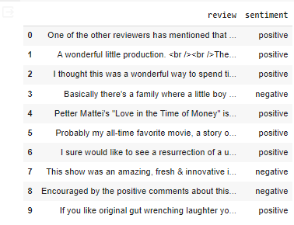
Q1: Loading in Data
Here is the output of df.head(10) before cleaning:

Slide 14
Q1: Work on Review Column
Cleaned the review column by removing HTML break tags and special characters, punctuation, and spaces. Then I dropped all duplicates in the review column as well as any NA values.
import re
# Remove all special characters, punctuation and spaces
df['review'] = df['review'].apply(lambda x: re.sub(r'[^A-Za-z0-9]+',' ',x))
# Replace special characters,<br />, in the file
df['review'] = df['review'].apply(lambda x: re.sub(r"<br />", " ", x))
# Added in code to drop data, variable df2 to print original dataframe shape later
df2 = df
df = df.drop_duplicates(subset=['review'], keep='first')
df = df.dropna()

Slide 15
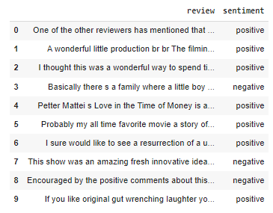
Q1: Dataframe after Cleaning
The dataframe after cleaning:
Removing duplicates removed 421 rows from the dataframe:
Shape of dataframe before dropping duplicates: (50000, 2)
Shape of dataframe after dropping duplicates: (49579, 2)

Slide 16
Q2: Embed the Review Column
Created a sample df of 5000 records for computational purposes. My device couldn’t handle larger samples:
df = df.sample(n=5000)
Then applied a get_embedding function to the review column:
def get_embedding(text):
try:
print("used")
embeddings = OpenAIEmbeddings()
result = embeddings.embed_query(text)
except:
print("text", text)
result = np.zeros(512)
return result
df['review'] = df['review'].apply(get_embedding)

Slide 17
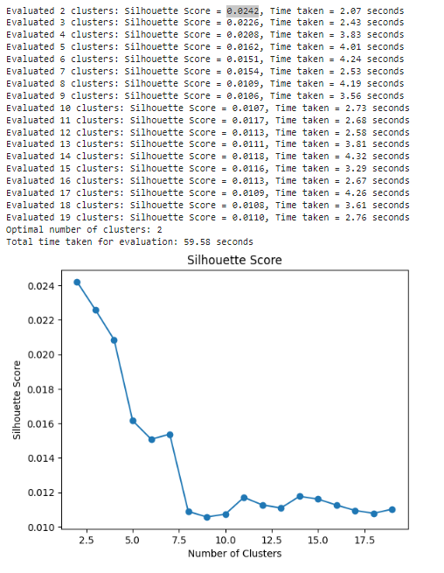
Q3: Find the Optimal Number of Clusters
The optimal number of clusters for our sample is 2, given that it has the largest silhouette score with 0.0242. This is visually represented by the graph where the silhouette score for 2 clusters is the graph's peak.

Slide 18
Q4: Perform Cluster Embedded Messages via K-means
Set n_clusters = 2 given the optimal clusters found in question 3. Then created a K-Means and fit this to the embedding matrix. The labels for K-Means are saved in a new dataframe column.
n_clusters = 2
kmeans = KMeans(n_clusters=n_clusters, init="k-means++", random_state=42, n_init='auto')
kmeans.fit(embeddingMatrix)
labels = kmeans.labels_
#add the predicted cluster ID to the data frame
df["Cluster"] = labels
df.groupby("Cluster")

Slide 19
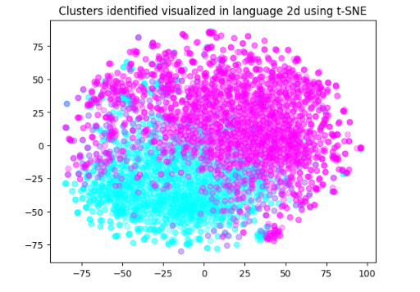
Q5: Visualize the Clusters using T-SNE
The embedding matrix has the shape of (5000, 1536). Since we cannot find the 1536 dimension, it must be reduced to the 2nd dimension.
T-SNE is used to reduce this matrix to the 2nd dimension so that it can be used to visualize the clusters.

Slide 20
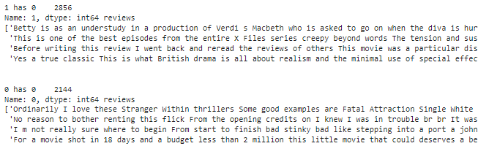
Q6: Sort Clusters by Size and Eyeball Clusters
The data is sorted by size and eyeball clusters to see if each item has similarities to other items in the cluster.
The items seem to have similarities to the other items within their cluster.

Slide 21
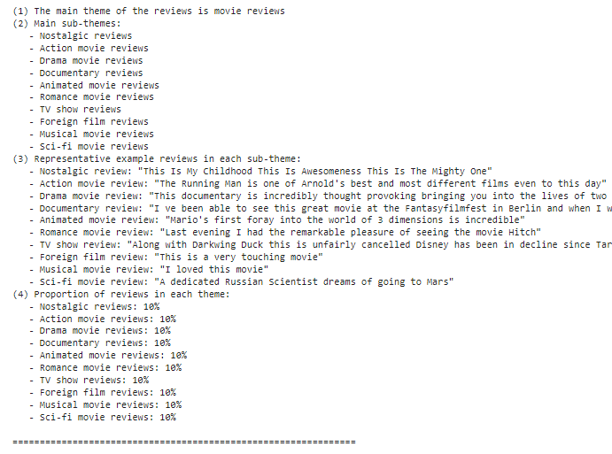
Q7: Summarized Sentiment using GPT-3.5
Cluster 0:
The summary of our sentiment broke the reviews into sub-themes of movie genres: nostalgic, action, drama, documentary, animated, romance, TV show, foreign, musical, and sci-fi.

Slide 22
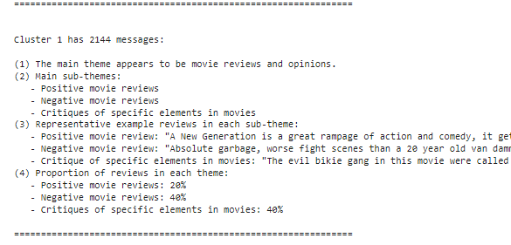
Q7: Summarized Sentiment Using GPT-3.5 (cont.)
Cluster 1:
The summary of our sentiment broke the reviews into sub-themes of opinions: positive reviews, negative reviews, and critique of specific elements (neither positive nor negative).

Slide 23
Problems Faced

Slide 24
PART I: Problem Faced; Rate Limit Reached
I received a rate limit exceeded code where I could not run any codes for 24 hours while trying to synthesize my data.
This problem could’ve been solved with the creation of a new OpenAI account + API key, or through purchasing a data plan.
I opted to wait the 24 hours to use my same OpenAI account for free.

Slide 25
PART II: Problems Faced; Failed Importing
Forgot to import OpenAIEmbeddings: from langchain_openai import OpenAIEmbeddings
Which does not throw an error if not imported.
This resulted in the application of ‘get_embedding’ on the entire dataset, without sampling, happening in just 14 seconds. This code however, was not actually embedded, as every line passed through the ‘except:’ of the get_embedding function after failing in the ‘try:’.

Slide 26
PART II: Problems Faced; Handling Except
Errors may occur where the ‘except: ‘ in the ‘get_embedding’ function is accessed, leaving a numpy array of 512 0s instead of an embedded list. This would result in errors when creating the embedding matrix:
ValueError: setting an array element with a sequence. The requested array has an inhomogeneous shape after 1 dimensions. The detected shape was (10,) + inhomogeneous part.
The code below handled these errors by removing the numpy arrays and leaving only our embedded data.
#CODE FOR NOT COMMENTING ON RESULTS (CLEAN 0s, NOT EMBEDDED)
df = df[~df['review'].apply(lambda x: all(val == 0 for val in x))]
df.reset_index(drop=True, inplace=True)

Slide 27
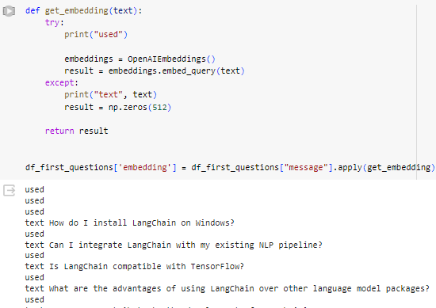
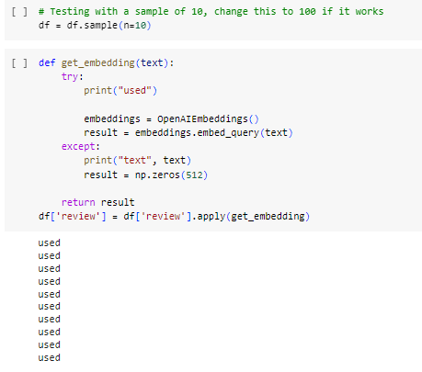
PART II: Problems Faced; Rate Limit
Example of a successful embedding on a dataframe sample of 10.
Example of an unsuccessful embedding on a dataframe.

Slide 28
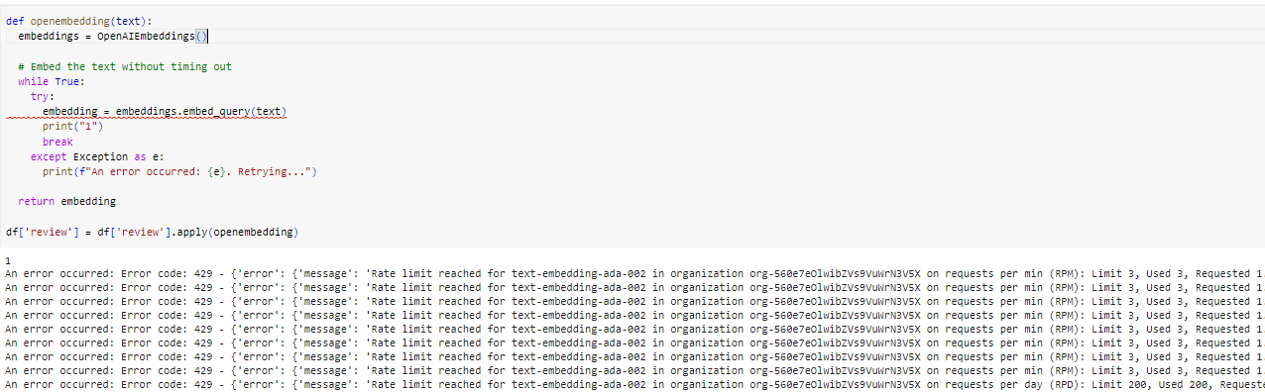
PART II: Problems Faced; Rate Limit Exceeded (cont.)
I created an ‘openembedding’ function to try to embed my data until successful, while returning the exceptions for fails.

Slide 29
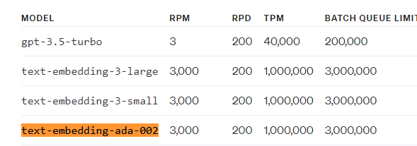
PART II: Problems Faced; Rate Limit Exceeded (cont.)
Using the error codes from the last slide, I decided to look into the rate limits for my account, and it was there that I found my problem within my account’s rate limit. This rate limit led to embedding only succeeding 5 time in a data sample of 100. This problem was solved by paying $5 of API credits to get access to the correct RPM.
For some reason, the RPM for my account was only 3.
The RPM for a free account should be 3,000.

Slide 30
THANK YOU!

